Slide 1
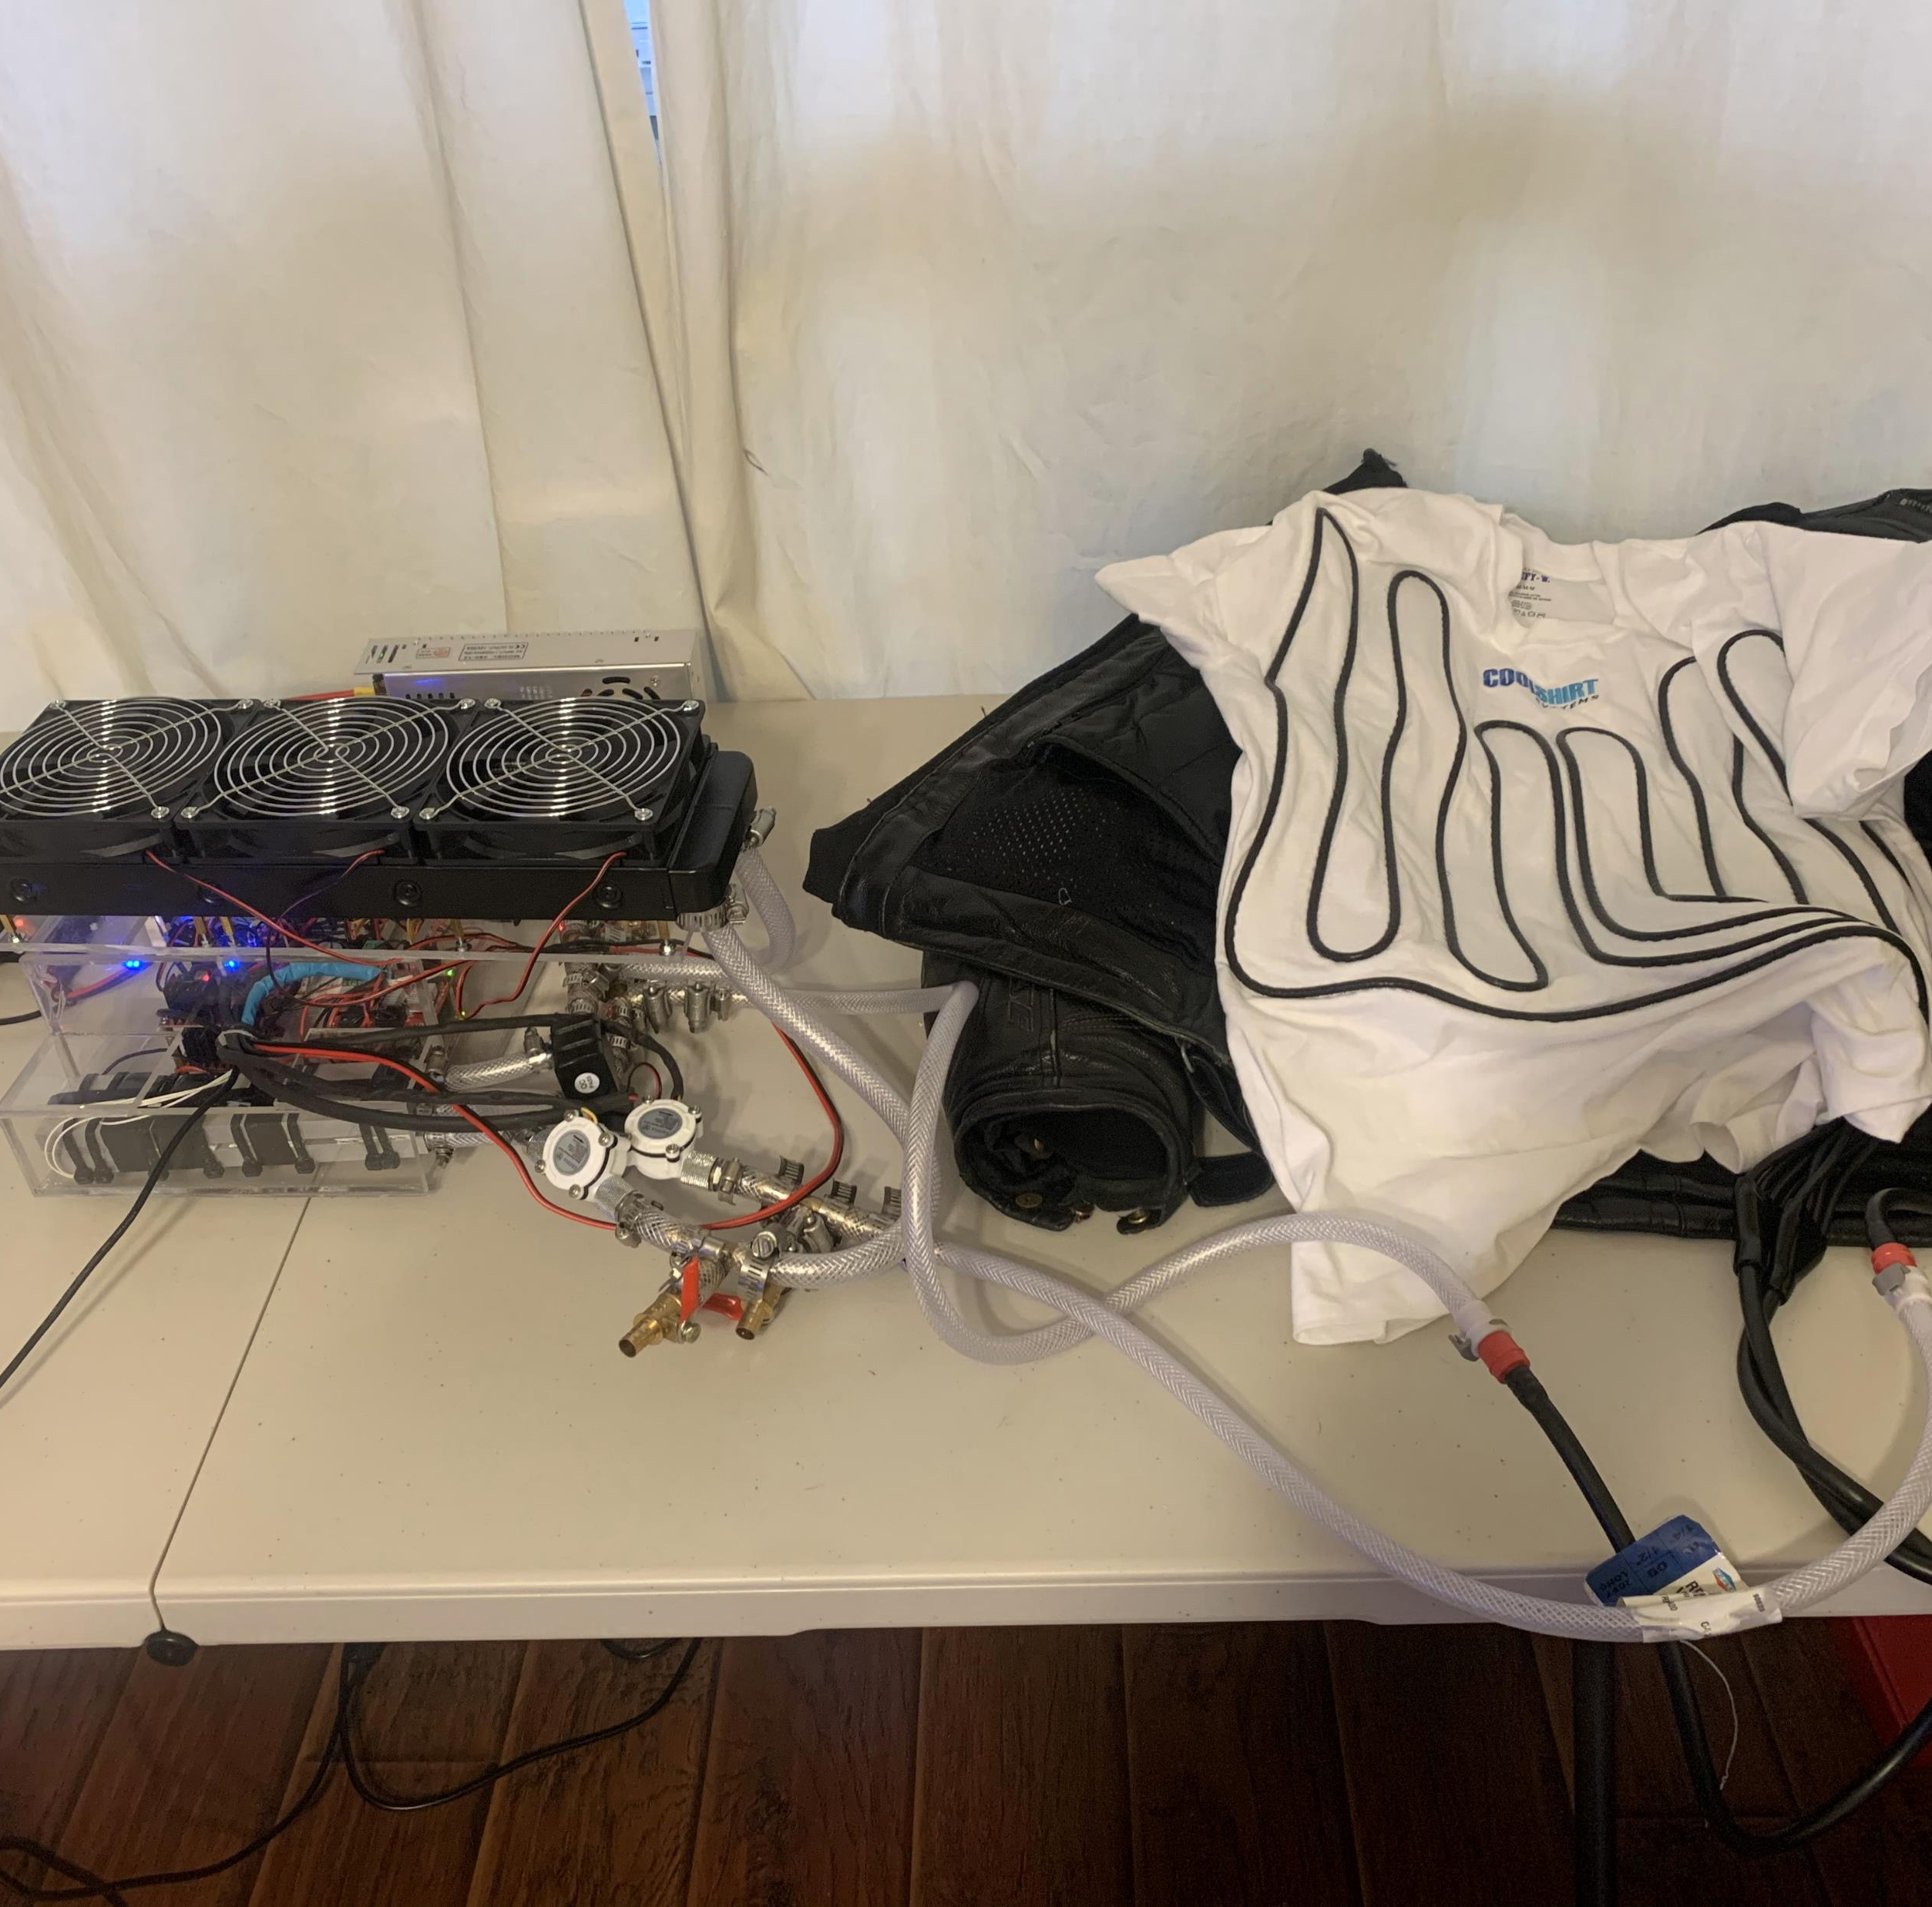
Personal Climate Control
Jonathan Martin
jon.martini@gmail.com
https://github.com/JonDeMartini/PersonalClimateControl
Notes:
My name is Jonathan Martin. Welcome to a short presentation on the Personal Climate Control project. Source code, detailed parts lists, schematics and documentation can be found at the project web page on GitHub.

Slide 2
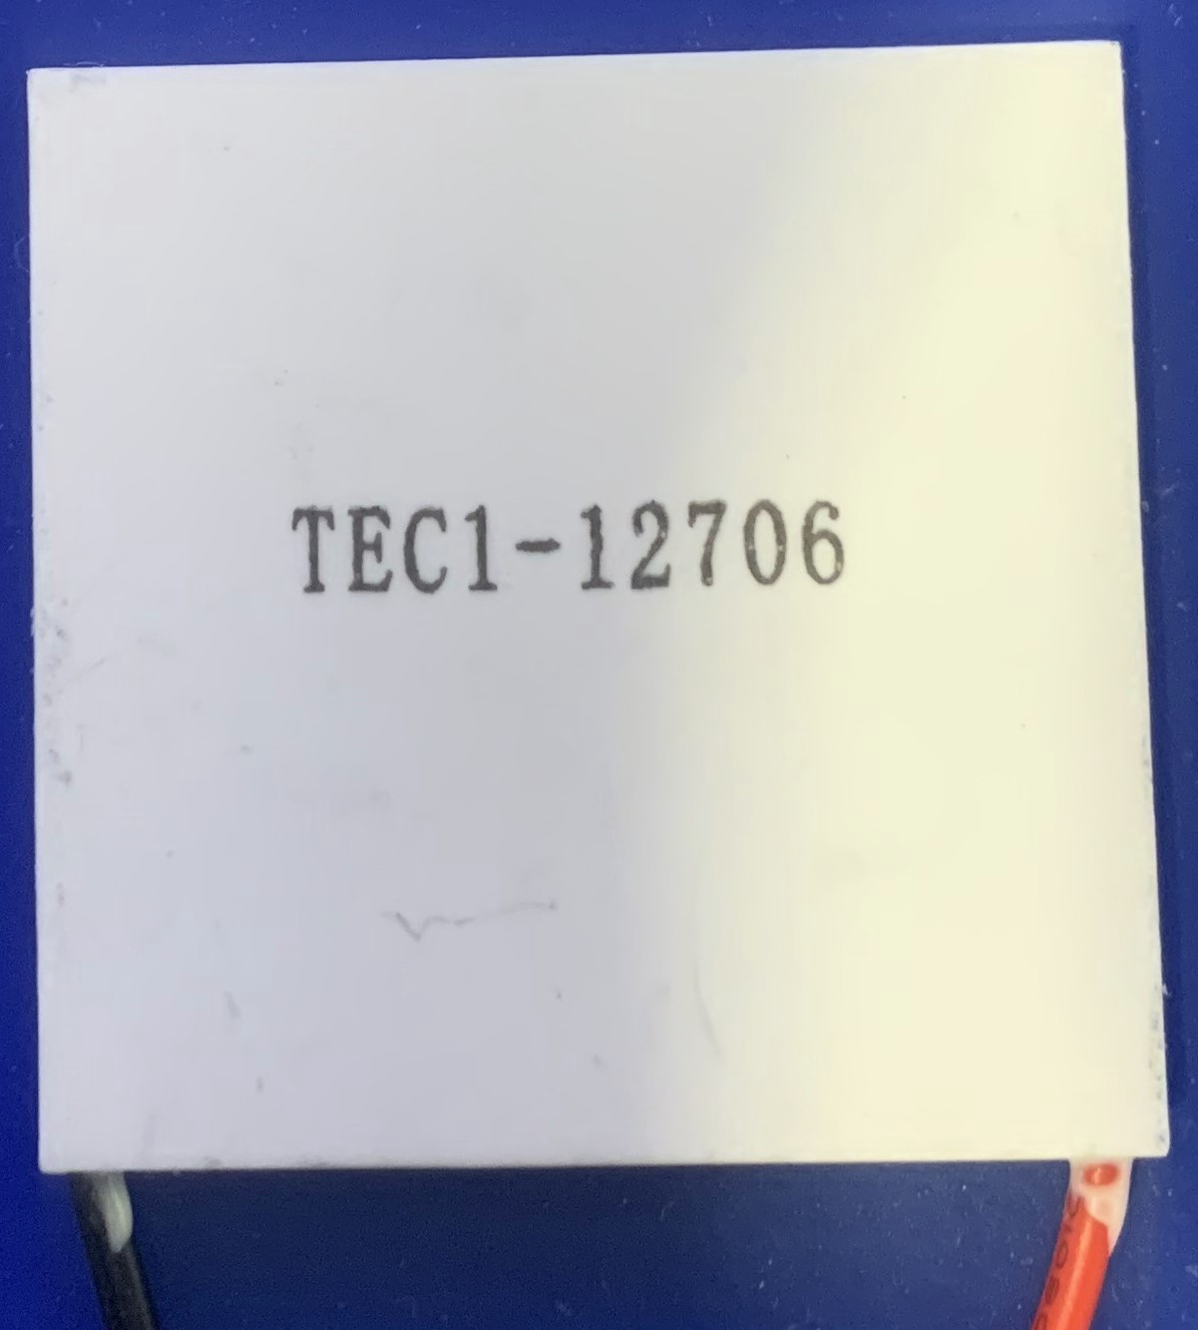
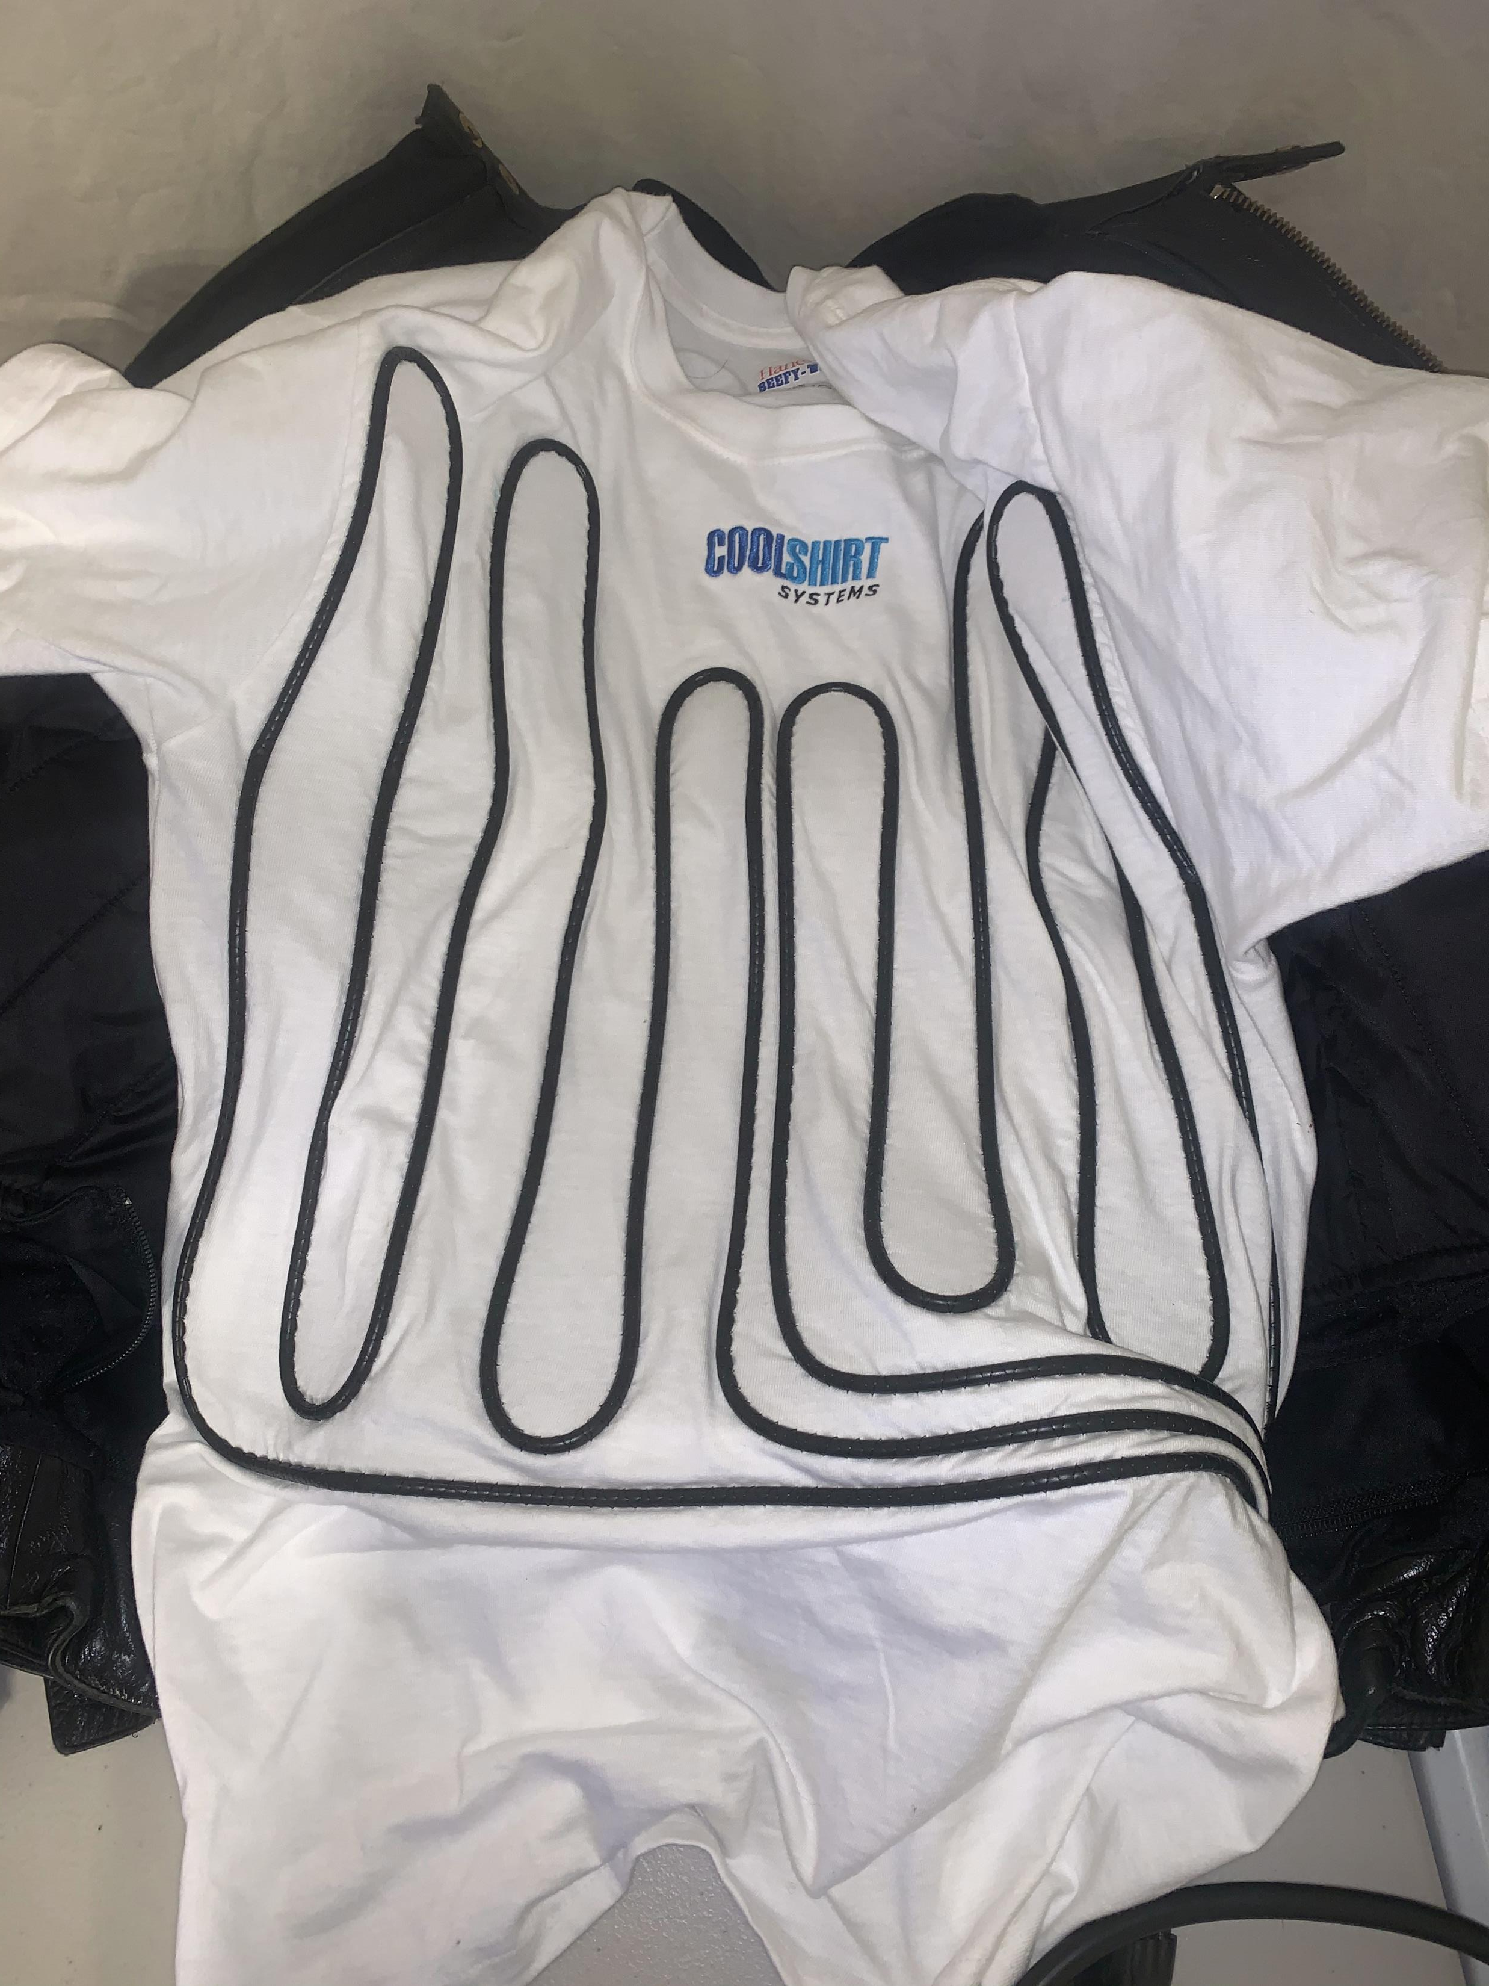
Concept
A cooling/heating device based on circulating cooled or heated water through a cooling shirt
Uses TECs for heating/cooling
Notes:
The basic concept is to use chilled or heated water pumped through a cooling shirt to make the user comfortable when other forms of climate control are unavailable. This is accomplished by using Thermoelectric coolers or TECs that can provide both heating and cooling. Similar concepts for cooling pump prechilled water from an insulated cooler or use refrigeration to chill water. Heating vests typically use resistive heaters. TECs where chosen for this project because they can provide both heating and cooling and have a small footprint. The challenge of using them is they aren’t as efficient at as dedicated heating and cooling systems. They do allow for one system that can be used year round.
The cooling shirt used is a commercially available shirt from CoolShirt Systems. It is basically a cotton t-shirt with about 15m of flexible tubing sewn in. In the next iteration a vest version that can be more easily used with a jacket will be used, as well as quick release valved connections that will allow connecting and disconnecting the shirt with minimal loss of water.

Slide 3
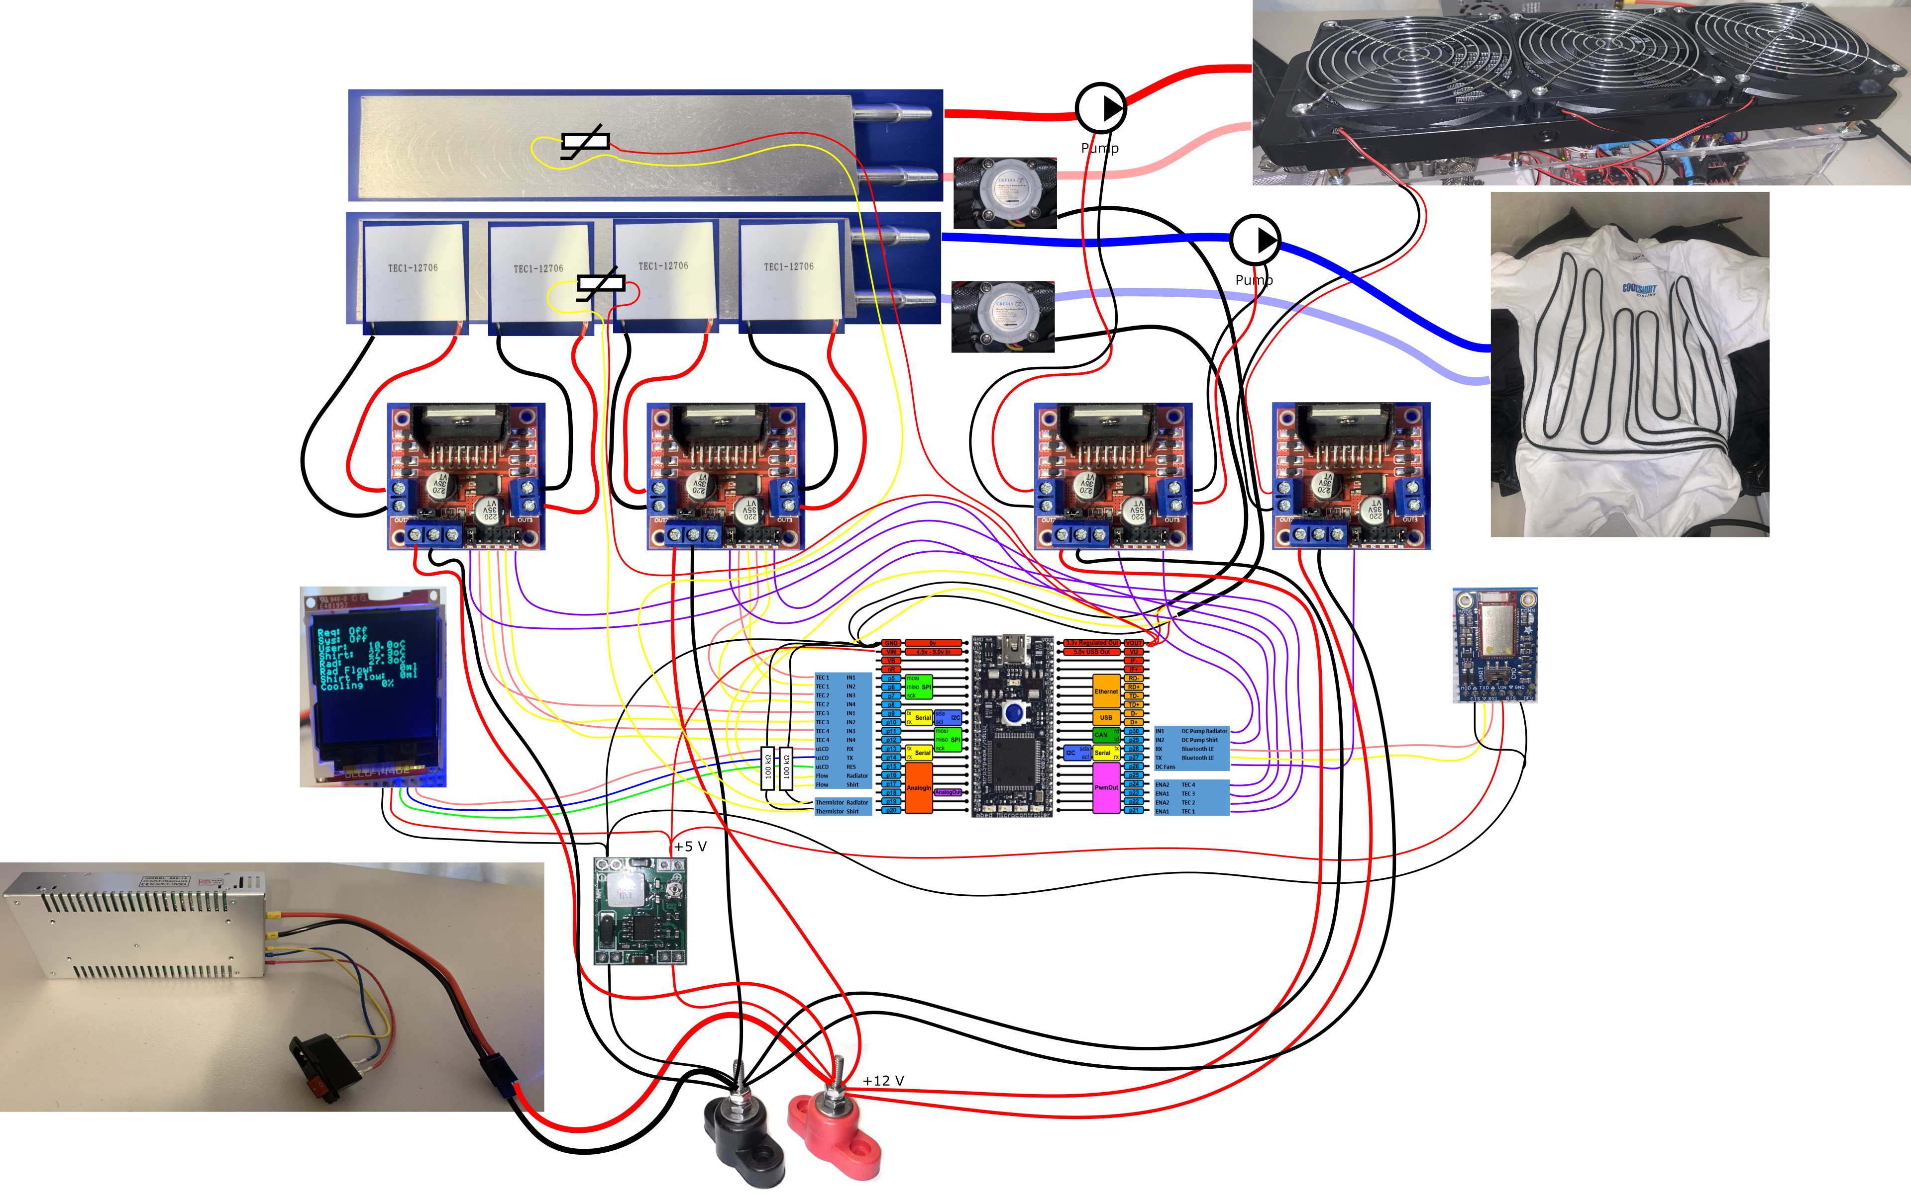
System Schematic
Notes:
The full system requires more than just TECs and a cooling shirt. Pumps are needed to circulate the temperature conditioned fluid. Flow meters keep track of how well the pumps are working. Dual H-bridges provide power to the TECs. A radiator and DC fans dissipate heat. Thermistors monitor the hot side and cold side temperatures of the TECs. A Bluetooth module allows the system be controlled from an App. A DC Regulator provides 5V power. And an mbed microcontroller ties everything together.
Lower power Dual H-Bridges are used to drive the pumps and radiator fans. These are rated at up to 2A per channel. The TECs used are TEC1-12706 models that are rated to draw up to 6A at 12V. The Dual H-bridges that drive these must be matched to safely drive that amperage. The ones selected are rated for up to 7A per channel.
Despite the rating of the TECs, the observed total power draw is only about 15A at 12V.
The eventual goal is to have a system that can be hooked up to 12V power on a motorcycle.
For the prototype we are using a 30A 12V DC power supply connected via an SAE connector which is a common power connection on motorcycles. This also defines our power limit. We can easily draw 20A from the motorcycles, but much beyond that could be an issue. Motorcycle stators don’t generate as much current as car alternators. Plus even at 20A we need thick gauge power cables. If you attempt your own version of this project, then for safety you should always use a fuse that is properly matched to the power cables you are using. It is better to blow a fuse than melt a cable or worse start a fire.

Slide 4
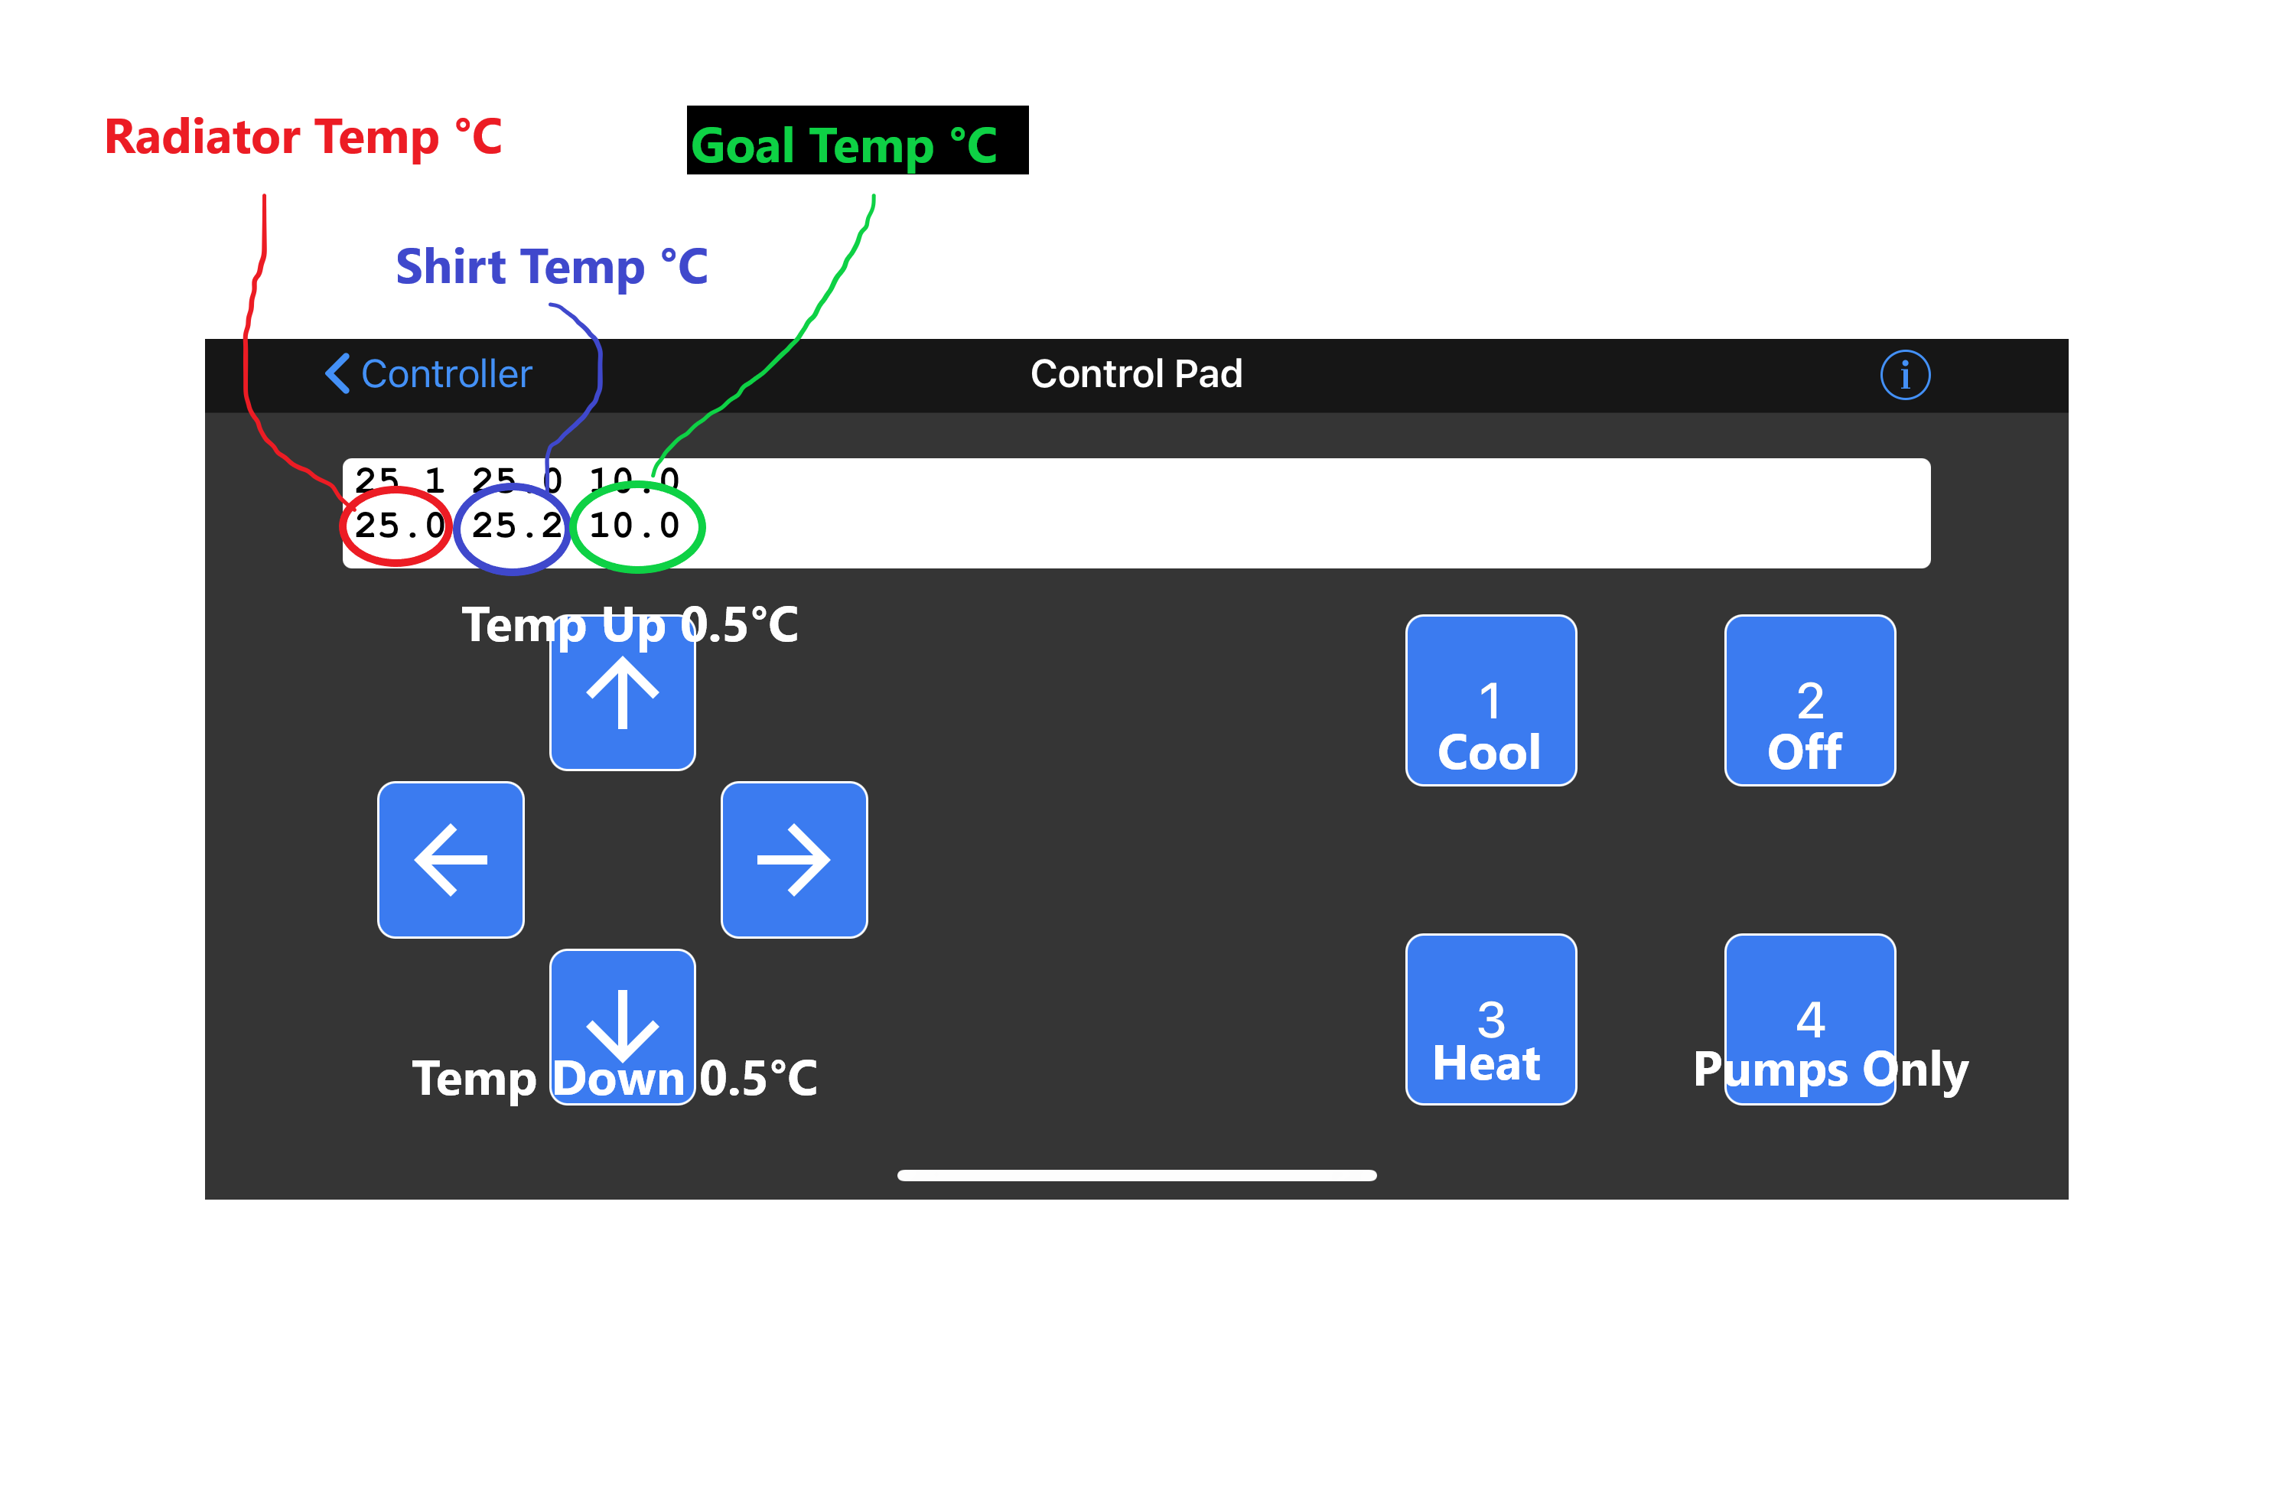
Control - Bluefruit Connect App
Notes:
The User interfaces with the system through a Bluetooth connected App on their phone. For this prototype we are using BluefruitConnect from Adafruit. The goal temperature can be increased on decreased and the user selected state can be set. The system functions as a state machine that has a user selected state that includes Off, Cool, Heat, and running only the pumps. Running only the pumps can be useful for filling the water loops and bleeding air from the system.
There are also several internal system states such as precool and run cool. In the event of overheating or a pump failure the system will automatically turn off.

Slide 5
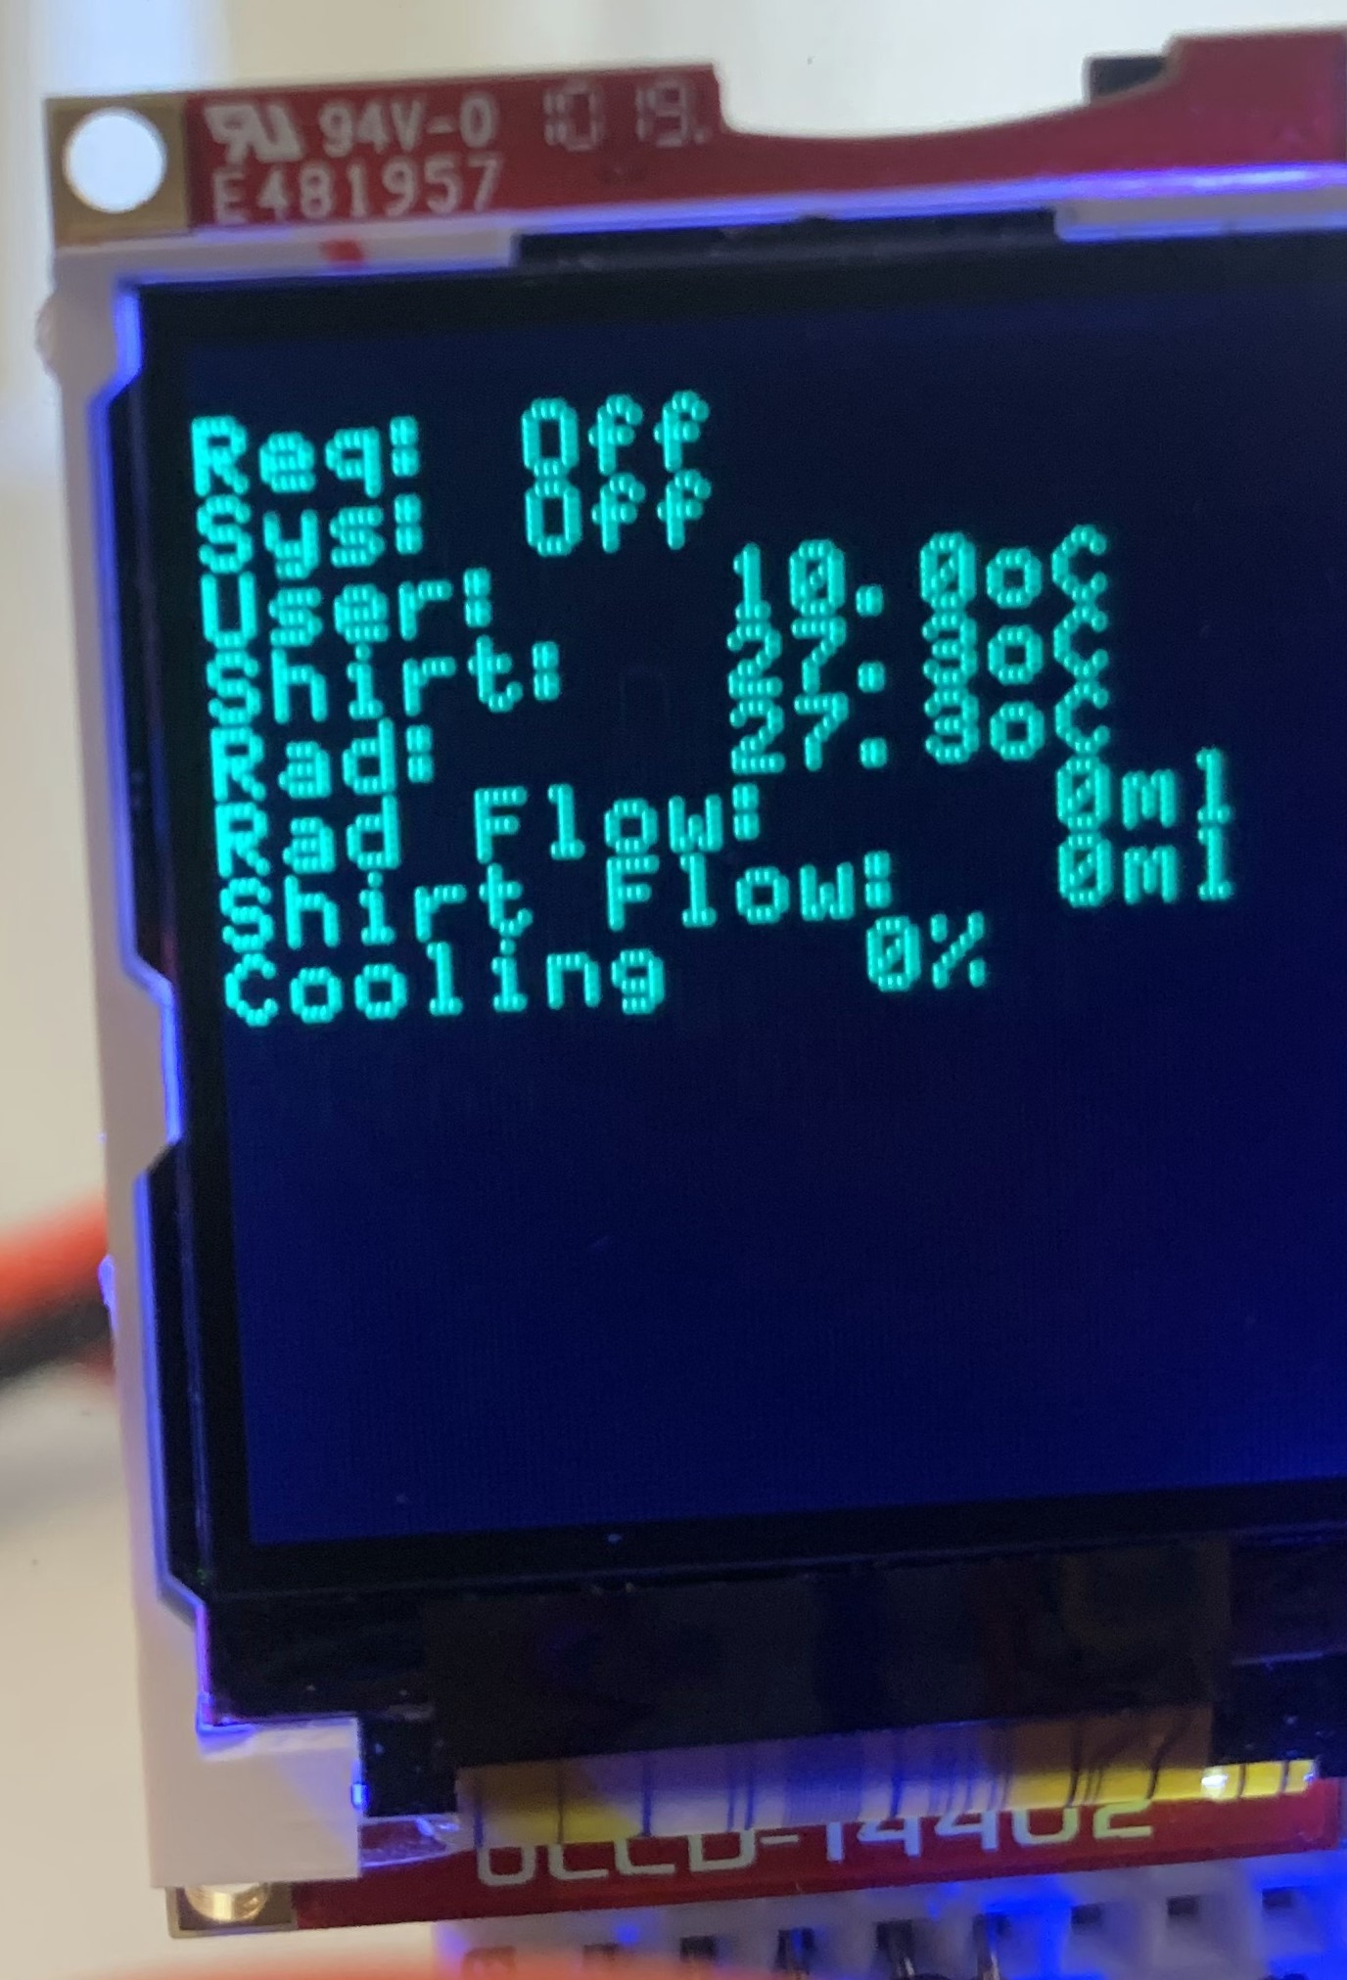
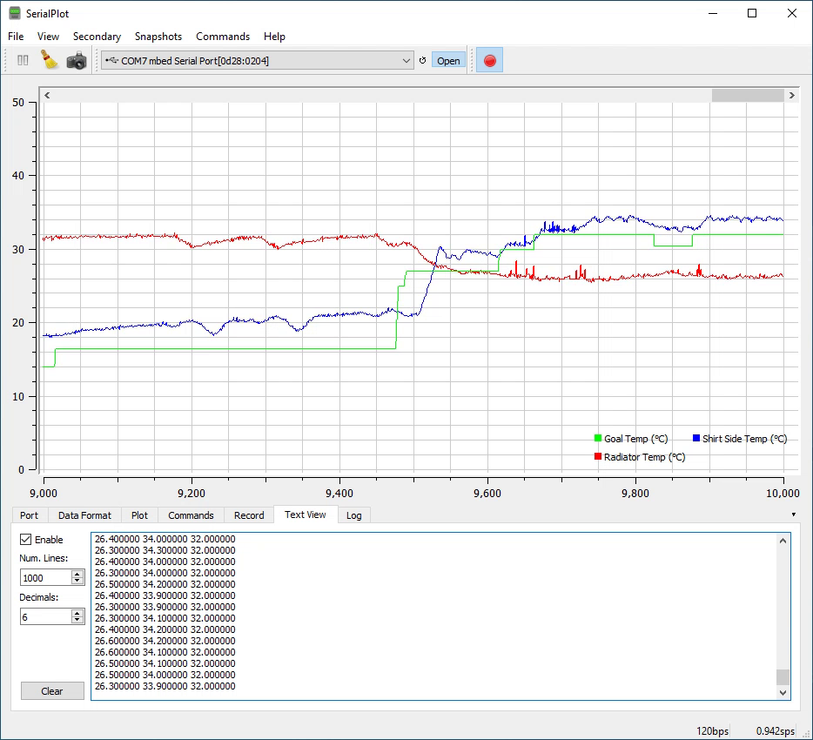
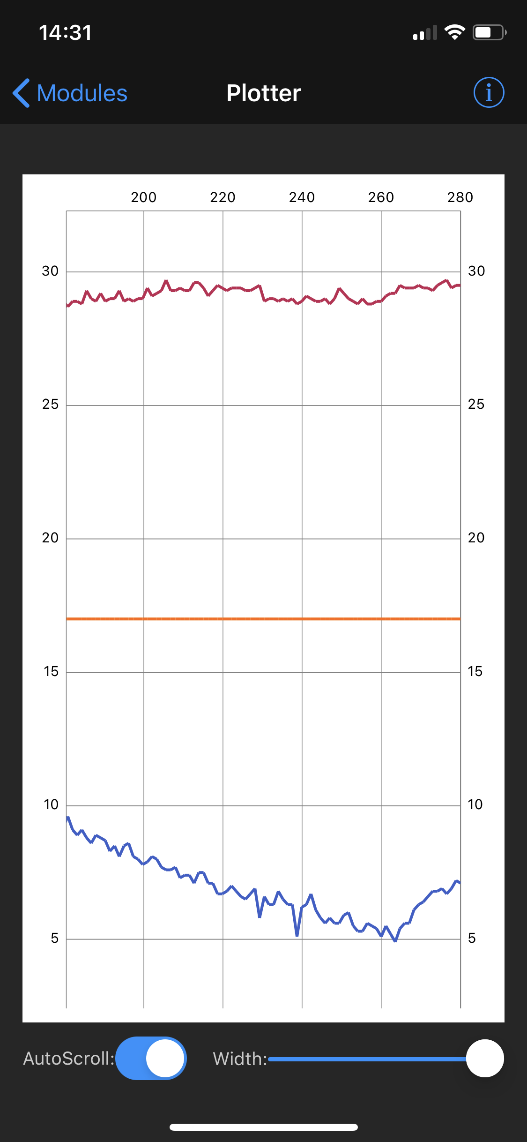
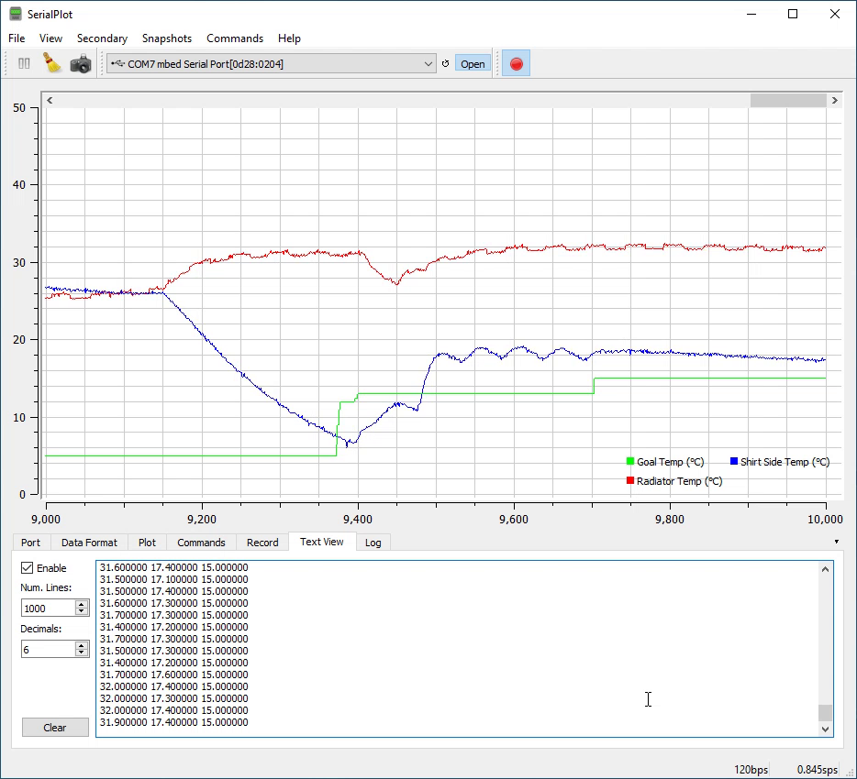
Data Output & Performance
Heating
Cooling
Notes:
The Plotter screen of the Bluefruit Connect App shows the temperatures of the radiator and shirt water blocks over time. An LCD screen displays state information, temperature and flow rates. These are mainly useful for debugging and aren’t of much interest to a user. A PC can also be connected to get real-time temperature reports over serial. The system performs well, able to cool reliably below 18 deg C under load. Heating to any reasonable temperature wasn’t an issue, though before this system is seriously used to heat it would need to be re-designed to accommodate some form of anti-freeze. That would involve selecting pumps and radiators that would be non-reactive to whatever coolant was selected.
The TECs will be upgraded in the next iteration with a goal of cooling closer to 10 deg C and using more of the available power budget. Better pumps and integrated reservoirs will also be added. The pumps used in this version are cheap aquarium pumps that are barely up to the task of moving water through so much tubing on the shirt water loop. They function well at moving water through the comparatively shorter and less restricted radiator loop.
Reservoirs are desired because it was a major challenge bleeding air from the system and keeping it bled. The hose connections and clamps used also were prone to small leaks. Pumps, tubing and connectors from PC water cooler suppliers will be used, though they are a good bit more expensive.

Slide 6

Questions?
Please send all comments and questions to
jon.martini@gmail.com
Notes:
I thank you for your time if you’ve watched this far. Check out the demonstration video linked on the web page and feel free to send any questions or comments.

